Slide 1

MusicAI
Presentation

Slide 2

What is
MusicAI
?
Arush Gopalakrishnan, Miles Stephens, Ethan Senen
MusicAI is a model that recommends the user a playlist of songs based on what the users listens to.

Slide 3
Our Process
Spotify API data
Dataset
Song recs
KNN
01
02
03
We trained the AI model on a database containing 1 million songs from spotify. The database also contains additional metrics like acousticness, energy, etc.
Next, we integrated Spotify’s API and imported a library so that we could use it in python.
The last step we took was feeding the model data from Spotify’s API, reading liked songs, and then recommending music.

Slide 4
Model Architecture
Company Name
Date
K-nearest neighbors
Take in features of each song as positions in a multidimensional space.
Get input songs and find the mean of their characteristics.
Search for what is nearest in the space.
The closest songs will be recommended.

Slide 5
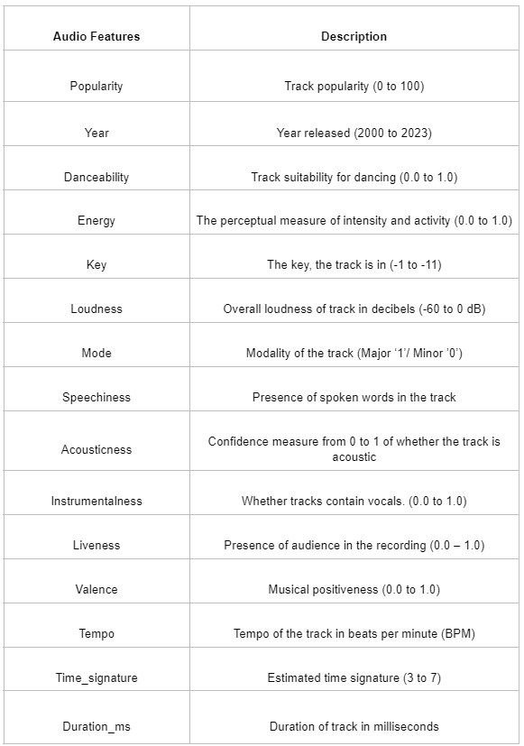
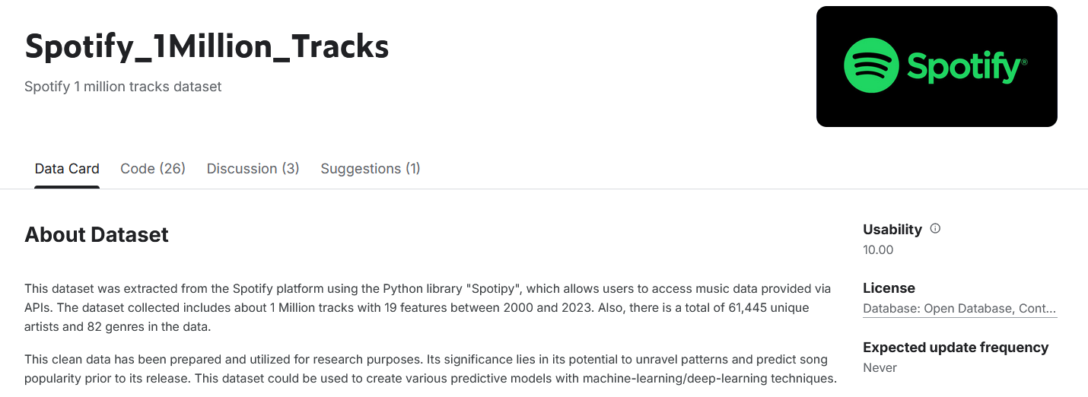
Data
We used a dataset from Kaggle, which contains over 1 million tracks, as well as lots of information.
Additionally, we did some minor preprocessing by filtering out songs with a popularity of 0 and removing songs that had invalid values.

Slide 6
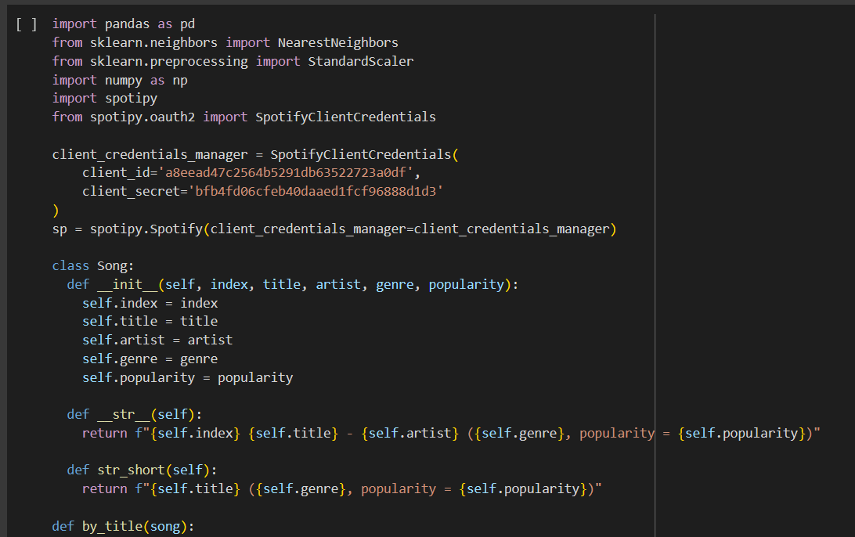
Demo

Slide 7
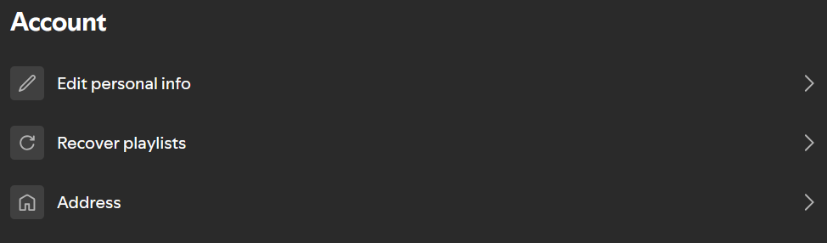
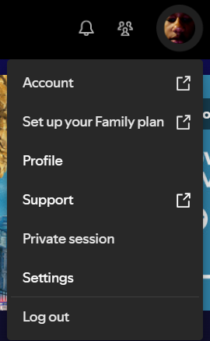
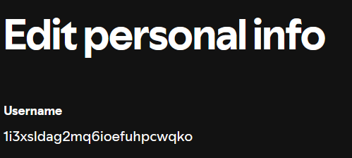
How to access your Spotify username:
Step 1: Click on your profile and go to ‘Account’
?
Step 2: The account page will tab you to your web browser, once there click on ‘Edit personal info’
Step 3: Copy this username into our AI model to generate results

Slide 8
Q&A
Any questions?
Ask away!

Slide 9
Thank you!

